Slide 1
Task 5 VIX Data Engineer
Inggriani Prisiclia

Slide 2
AGENDA
01
Business Objective
03
Insight
02
Exploration Data
04
Conclusion and Solution

Slide 3
ABOUT DATA
This data talk about customers who have a credit card before and still do. Some of customers (Attrited Customers) already done and do not want to use a credit card again, so we need to know why their no churn.

Slide 4
01
Business Objection

Slide 5

MAKE A LIST
Indentify factors that makes the customers do not want to use credit card again
Indentify the Characters of customers
Indentify the Capacity of customers
Indentify the Capital of customers
Indentify the Collateral of customers
Indentify the Condition of customers

Slide 6
02
Exploration Data

Slide 7
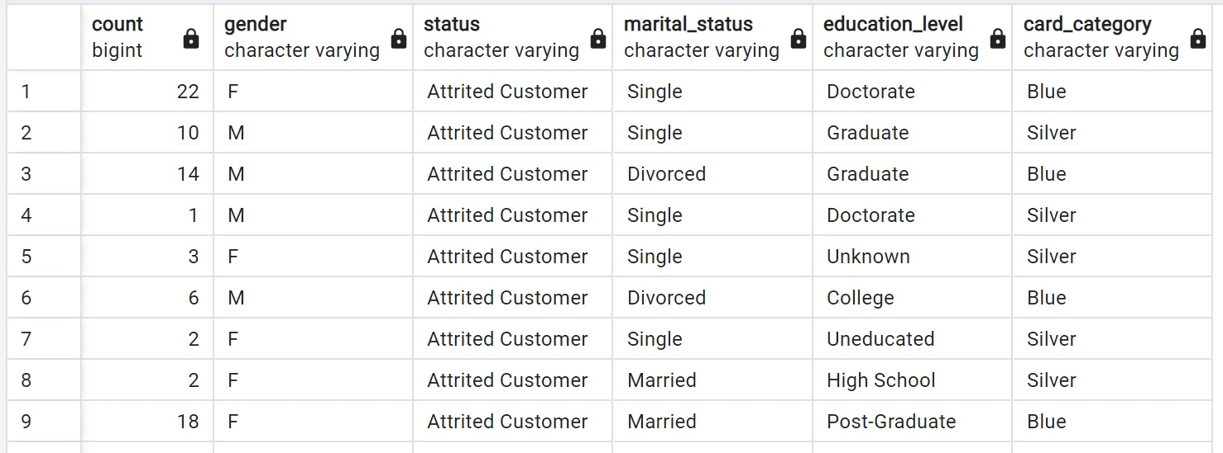
SELECT
COUNT (ch.CLIENTNUM),
ch.gender,
s.status,
ma.Marital_Status,
e.Education_level,
ca.Card_Category
FROM customer_data_history as ch
JOIN status_db as s on ch.idstatus = s.idstatus
JOIN marital_db as ma on ch.Maritalid = ma.Maritalid
JOIN education_db as e on ch.Educationid = e.Educationid
JOIN category_db as ca on ch.card_categoryid = ca.card_categoryid
GROUP BY 2,3,4,5,6
ORDER BY 3;

Slide 8
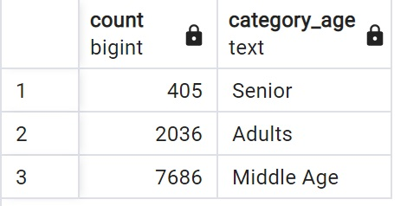
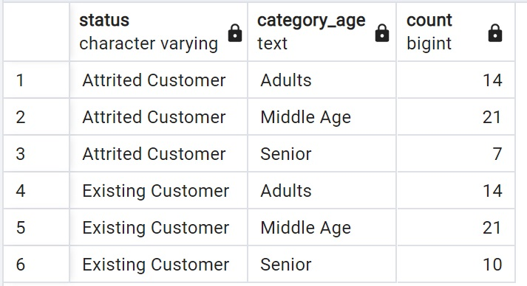
SELECT
COUNT(CLIENTNUM),
CASE WHEN Customer_Age <=39 then 'Adults'
WHEN Customer_Age <=60 then 'Middle Age'
WHEN Customer_age >60 then 'Senior'
end as Category_Age
FROM customer_data_history
GROUP BY 2;
SELECT
a.status,
a.Category_age,
Count(a.Category_age)
FROM(
SELECT
s.status,
c.Customer_age,
CASE WHEN c.Customer_Age <=39 then 'Adults'
WHEN c.Customer_Age <=60 then 'Middle Age'
WHEN c.Customer_age >60 then 'Senior'
end as Category_Age
FROM customer_data_history c
JOIN status_db as s on c.idstatus=s.idstatus
GROUP BY 1,2
)as a
GROUP BY 1,2;

Slide 9
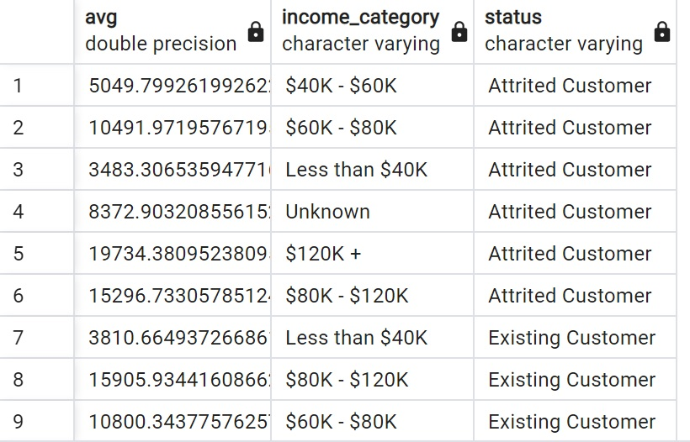
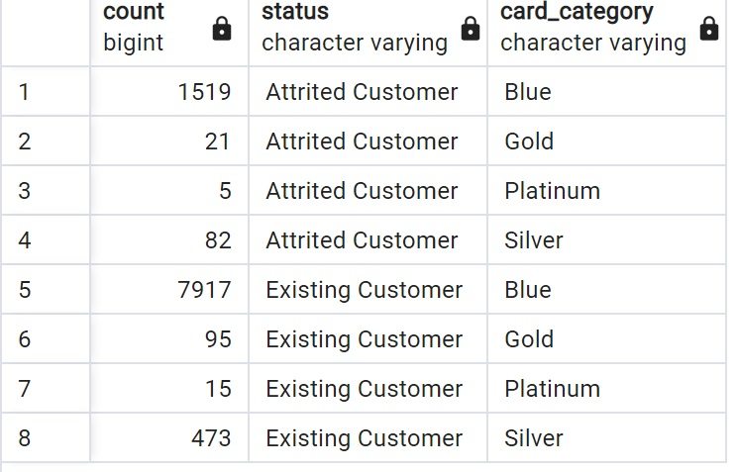
SELECT
AVG(c.Credit_Limit),
c.Income_Category,
s.status
FROM customer_data_history as c
JOIN status_db as s on c.idstatus = s.idstatus
GROUP BY 2,3
ORDER BY 3;
SELECT
count(c.Avg_Open_To_Buy),
s.status,
cc.Card_Category
FROM customer_data_history as c
JOIN status_db as s on c.idstatus = s.idstatus
JOIN category_db as cc on c.card_categoryid = cc.card_categoryid
GROUP BY 2,3
ORDER BY 2,3;

Slide 10
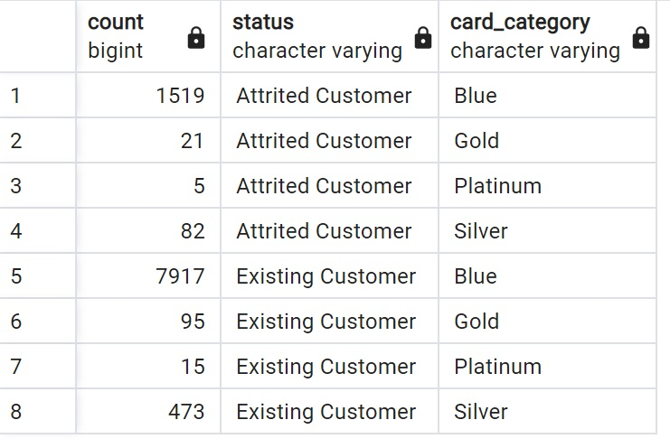
SELECT
count(c.Total_trans_amt),
s.status,
cc.Card_Category
FROM customer_data_history as c
JOIN status_db as s on c.idstatus = s.idstatus
JOIN category_db as cc on c.card_categoryid = cc.card_categoryid
GROUP BY 2,3
ORDER BY 2,3;

Slide 11
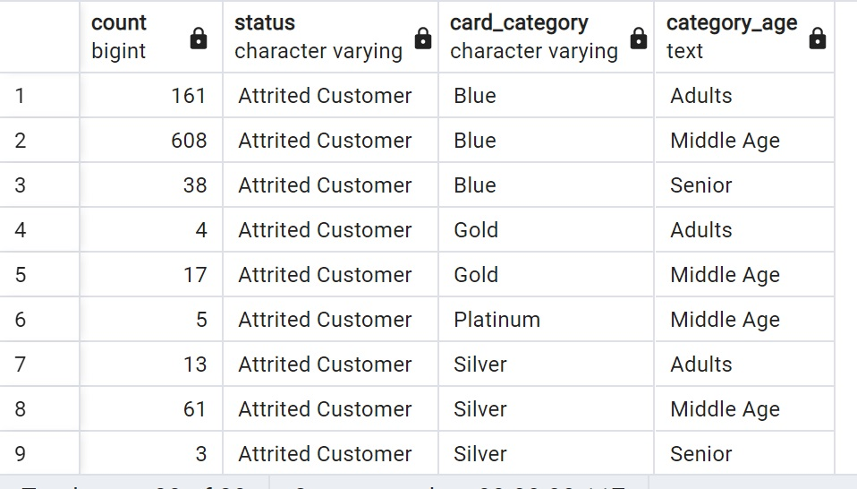
SELECT
count(pa.Total_Revolving_Bal),
pa.status,
pa.Card_Category,
pa.Category_Age
FROM(
SELECT
c.Total_Revolving_Bal,
c.Income_Category,
c.Customer_age,
s.status,
cc.Card_Category,
CASE WHEN Customer_Age <=39 then 'Adults'
WHEN Customer_Age <=60 then 'Middle Age'
WHEN Customer_age >60 then 'Senior'
end as Category_Age
FROM customer_data_history as c
JOIN status_db as s on c.idstatus = s.idstatus
JOIN category_db as cc on c.card_categoryid = cc.card_categoryid
GROUP BY 1,2,3,4,5
)as pa
GROUP BY 2,3,4
ORDER BY 2,3,4;

Slide 12
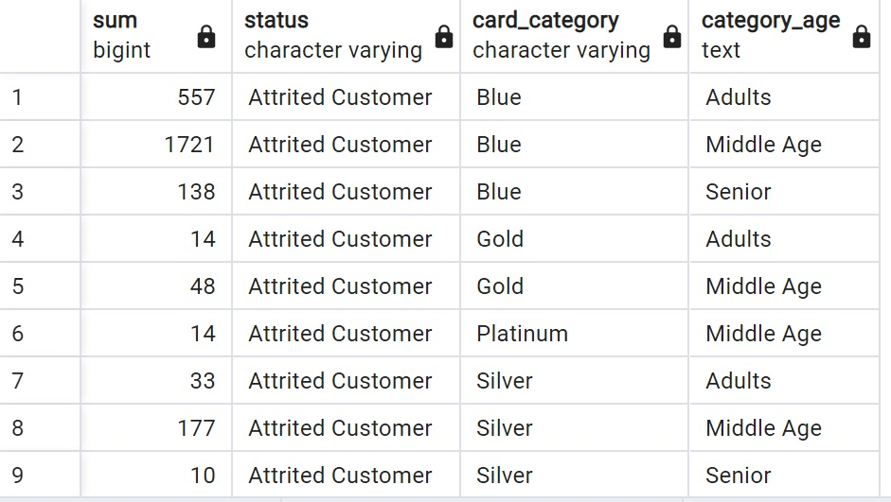
SELECT
sum(pa.Total_Relationship_Count),
pa.status,
pa.Card_Category,
pa.Category_Age
FROM(
SELECT
c.Total_Relationship_Count,
c.Income_Category,
c.Customer_age,
s.status,
cc.Card_Category,
CASE WHEN Customer_Age <=39 then 'Adults'
WHEN Customer_Age <=60 then 'Middle Age'
WHEN Customer_age >60 then 'Senior'
end as Category_Age
FROM customer_data_history as c
JOIN status_db as s on c.idstatus = s.idstatus
JOIN category_db as cc on c.card_categoryid = cc.card_categoryid
GROUP BY 1,2,3,4,5
)as pa
GROUP BY 2,3,4
ORDER BY 2,3,4;

Slide 13
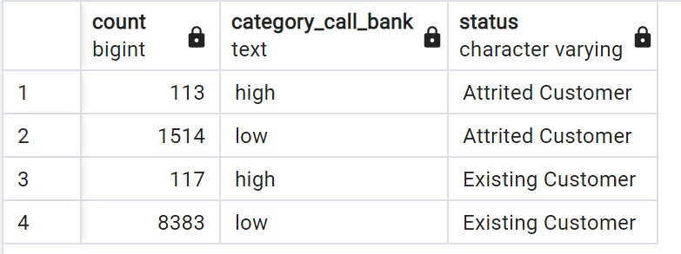
SELECT
sum(pa.Total_Relationship_Count),
pa.status,
pa.Card_Category,
pa.Category_Age
FROM(
SELECT
c.Total_Relationship_Count,
c.Income_Category,
c.Customer_age,
s.status,
cc.Card_Category,
CASE WHEN Customer_Age <=39 then 'Adults'
WHEN Customer_Age <=60 then 'Middle Age'
WHEN Customer_age >60 then 'Senior'
end as Category_Age
FROM customer_data_history as c
JOIN status_db as s on c.idstatus = s.idstatus
JOIN category_db as cc on c.card_categoryid = cc.card_categoryid
GROUP BY 1,2,3,4,5
)as pa
GROUP BY 2,3,4
ORDER BY 2,3,4;

Slide 14
03
Insight

Slide 15
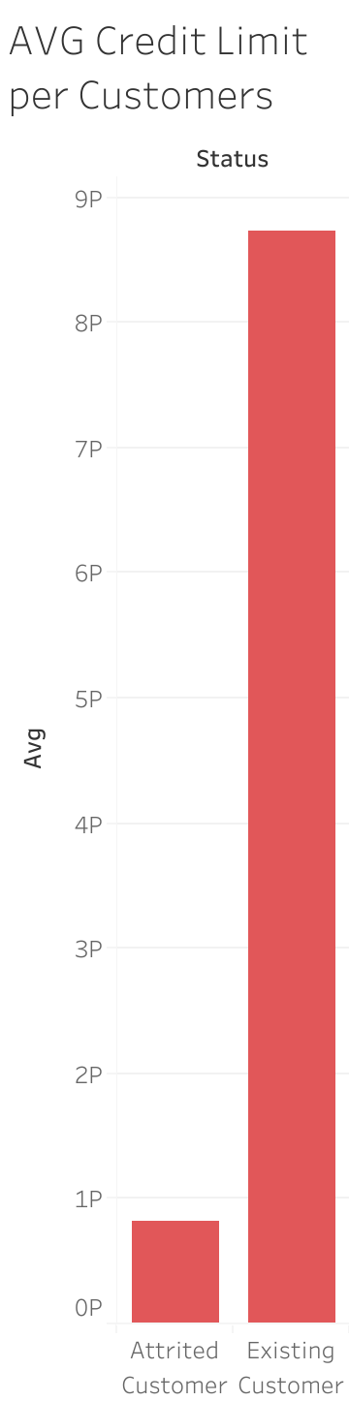
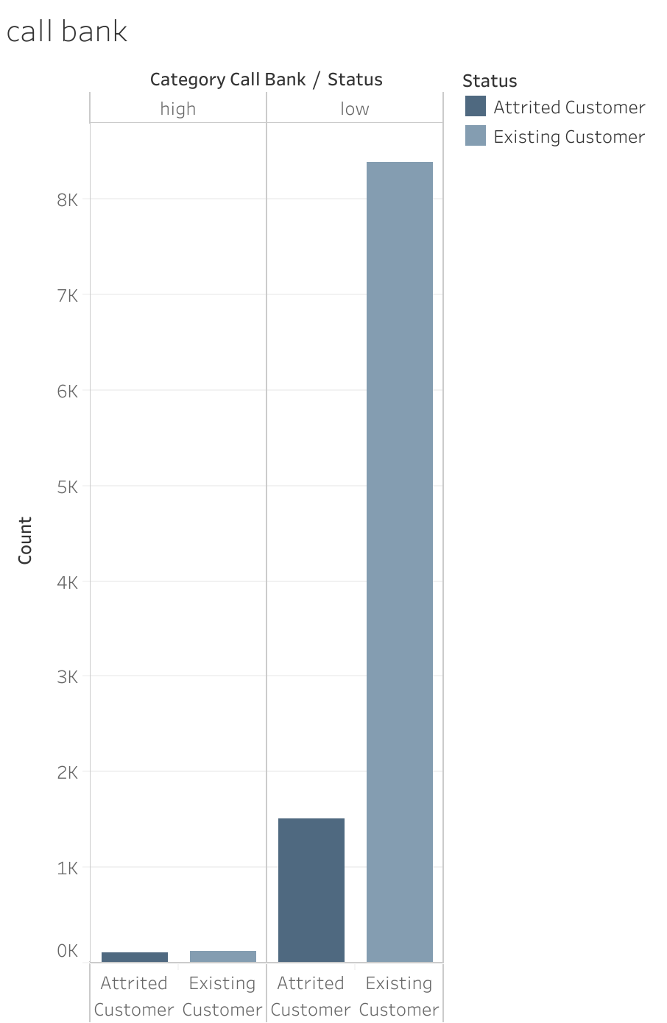
Existing Customers always get a call from bank.
Average Credit Limit for each Category of Customer is different. Attrited Customers has a low credit limit rather than Existing Customer

Slide 16
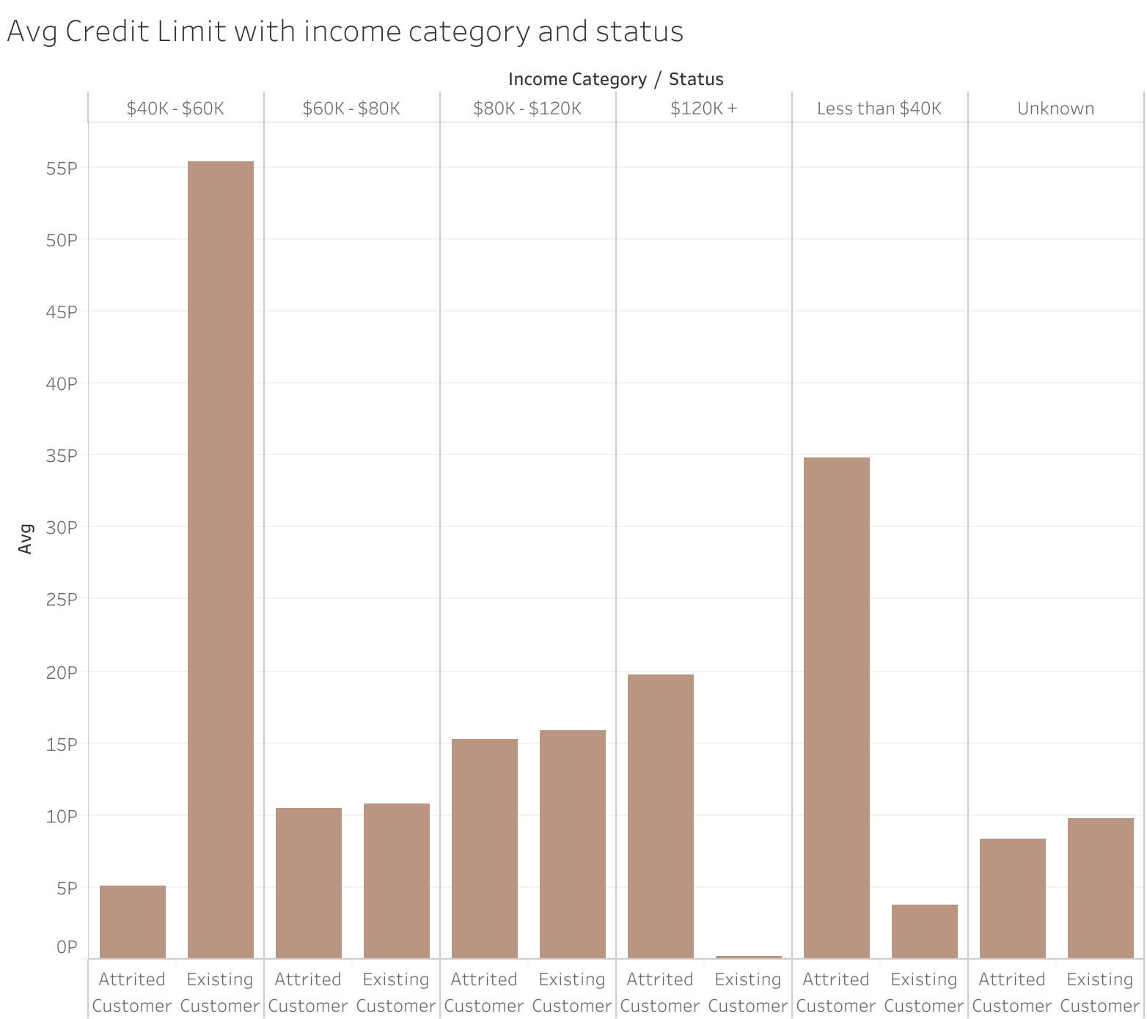
Existing Customers with income range $40k-$60k have the highest credit limit.
Attrited Customers with income less than $40k have the highet credit limit.

Slide 17
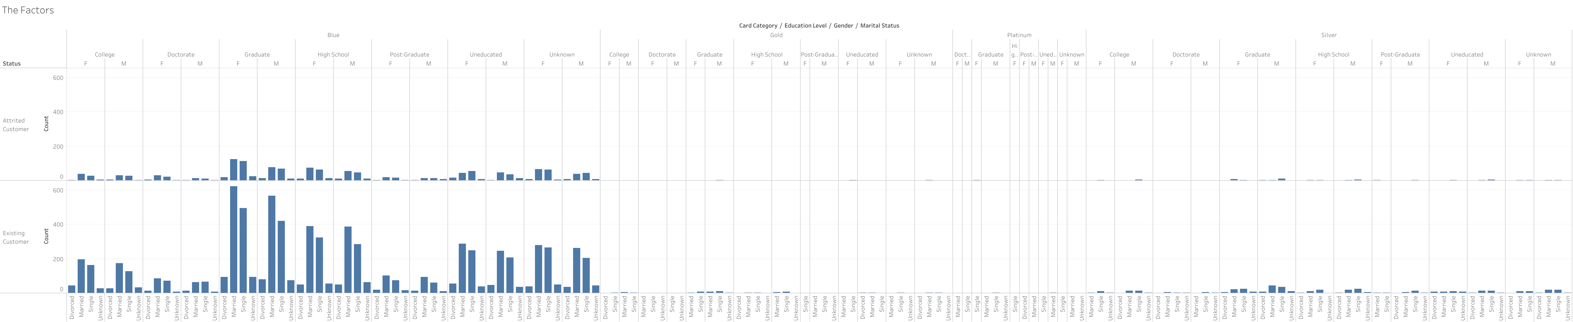
People who get married and graduate need to have a credit card

Slide 18
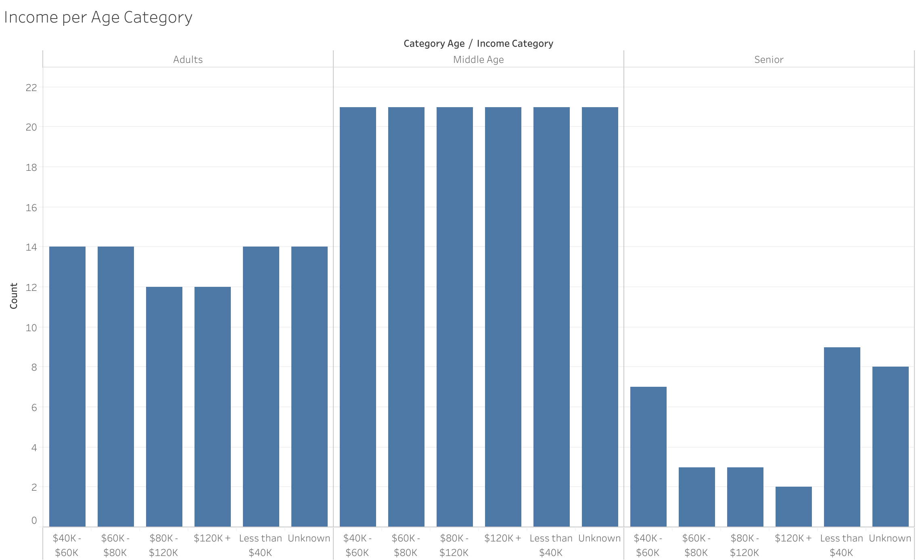
Middle age have flat result for income category.

Slide 19
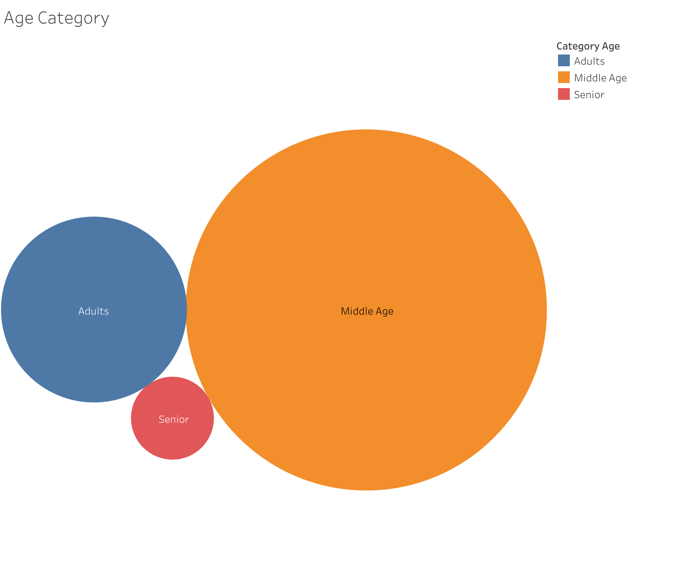
Middle age have a more use for credot card rather than another age category.

Slide 20
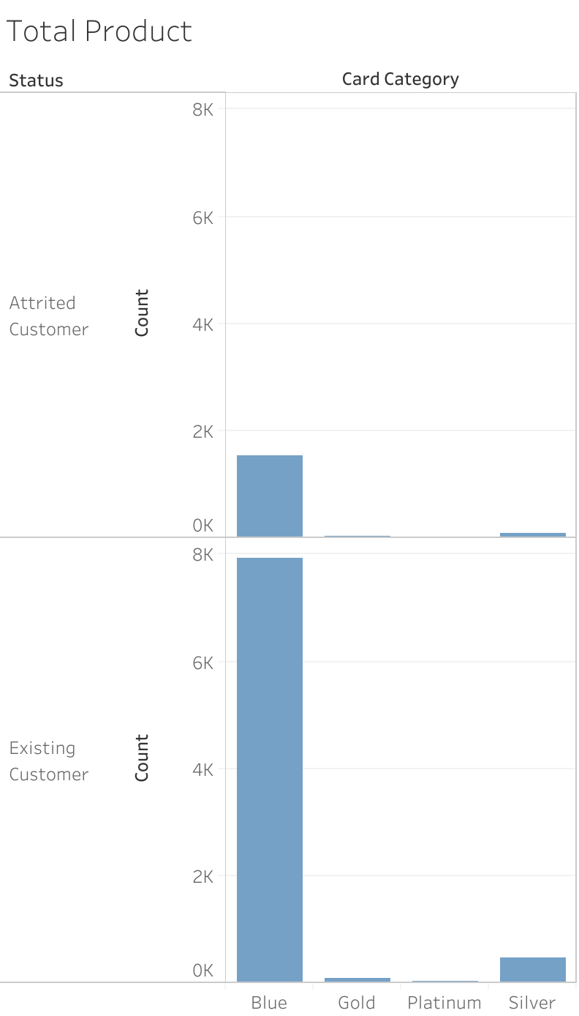
For both of status customers, who has a blue card have a many product that they want to buy.

Slide 21
04
Conclusion and Solution

Slide 22
Attrited Customers have a low credit limit, that’s why they don’t want to use credit card again. But, this a good thing to do because we don’t know their situation. If we want to increase their limit, we need to check their 5C (Characters, Capacity, Capital, Collateral, and Condition).
Existing Customers have a highest credit limit, this is because we know about them and their regularly use our credit card, but we also need to further review them again.
The biggest customers are Middle age. We need to cross check this policy about the age range so they still can to pay the credit. We need to approach the adults with the stable job and don’t give to the senior, if we need to, we have to extra review them condition and collateral.
For both customers category, we need to carefully take a look about their income and credit limit, do not exceed their salary and cause fail to pay the credit.
Total product that hold by customers in every category card has a different numbers. Blue card have a more products that customers hold. We can campaign for another card category, so customers can hold more in another card category rather than in blue. In example, give a discount or bonus for customers who can buy the product with their cards.
Give a easier application to customers who want to apply the credit and reasonable reasons for the credit limit in each of card category.

Slide 23
THANKS
Do you have any questions?
https://www.linkedin.com/in/inggriani-priscilia-69779b179/
https://github.com/inggridpris/Data-Engineer-for-Credit-Card

